Slide 1
DESIGN OF AUGMENTED REALITY AND VIRTUAL REALITY
- ROHAN N KALPAVRUKSHA
ROSHAN N KALPAVRUKSHA

Slide 2
SKETCH UP
SketchUp is a 3D modeling computer program for a wide range of drawing applications such as architectural, interior design, landscape architecture, civil and mechanical engineering, film & video game design.
Sketchup (formerly Google Sketchup) is 3D modeling software that’s easy to use and has an extensive database of user-created models available for download. You can use it to sketch (or import) models to assist with all kinds of projects—furniture building, video game creation, 3D printing, interior design, and whatever else you can think of.
SketchUp is an intuitive 3D modeling application that lets you create and edit 2D and 3D models with a patented “Push and Pull” method. The Push and Pull tool allows designers to extrude any flat surface into 3D shapes. All you have to do is click an object and then start pulling it until you like what you see.

Slide 3
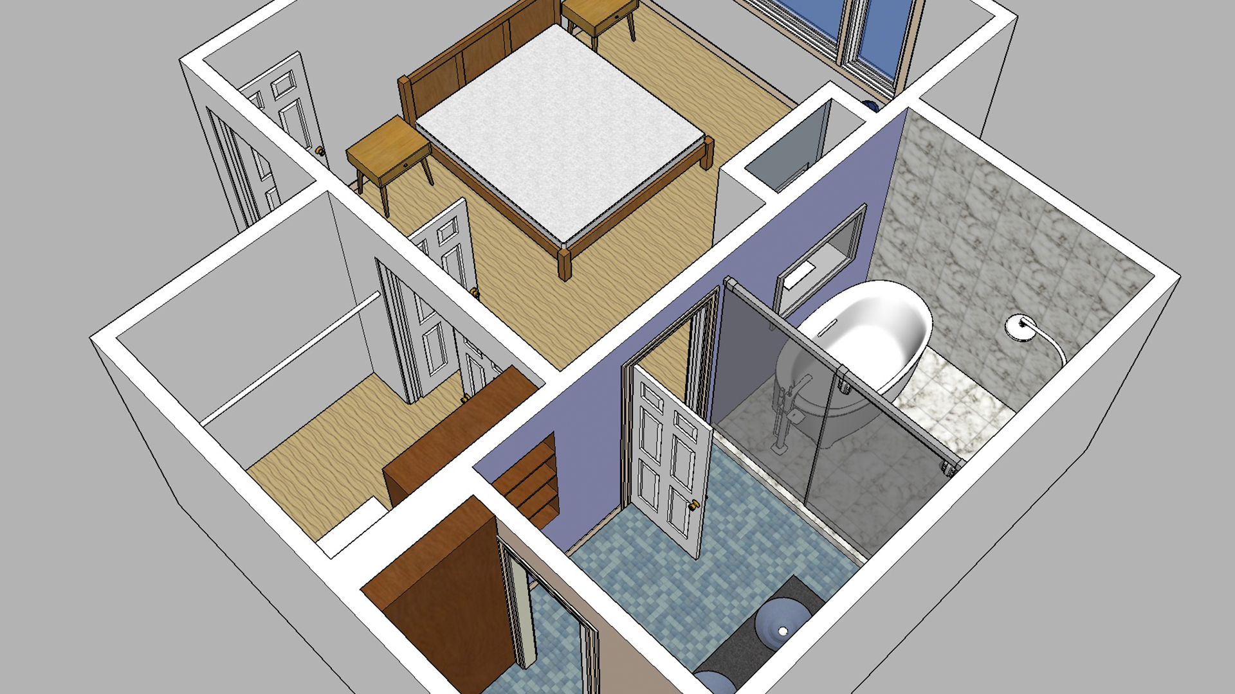
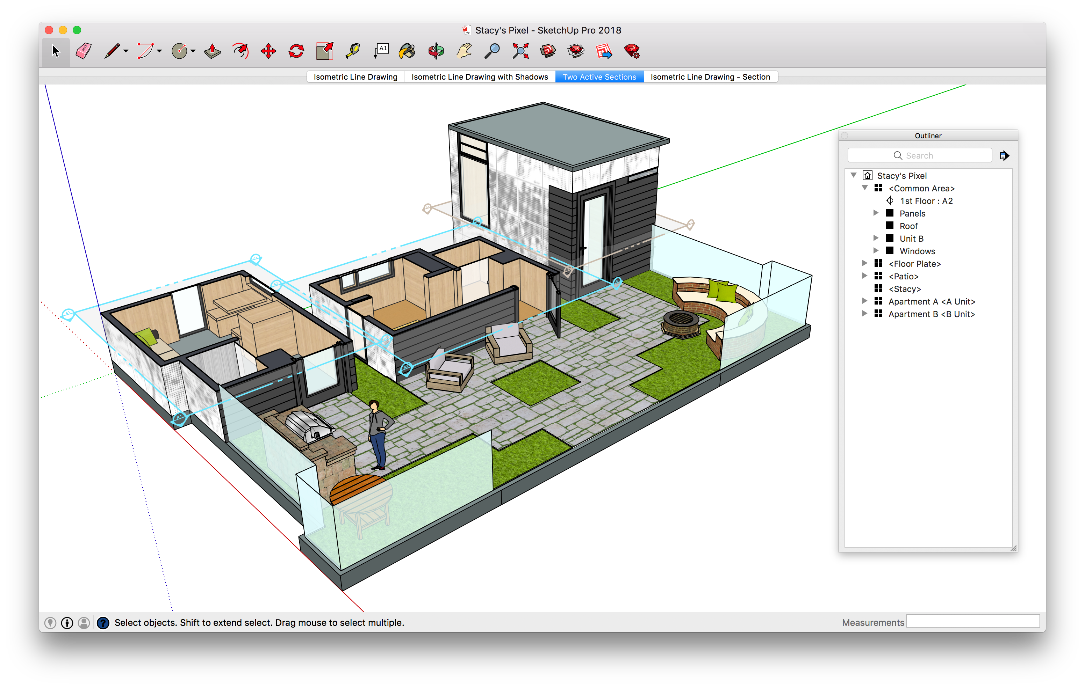
SKETCH UP
WILL HELP US BUILD STRUCTURES /ENVIRONMENTS USING VARIOUS TOOLS.

Slide 4
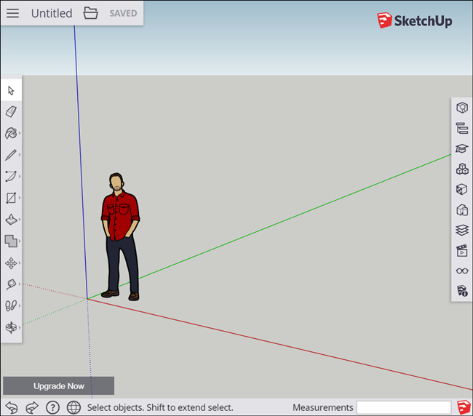
FUNCTIONS OF SKETCHUP
PUSH
PULL
CUTTING HOLES
INTERFERNCING
REMOVING GEOMTRY
CHANGE FACE MODE
INTERSECT MODELS
EXTRUDE MODELS

Slide 5
TOOLS OF SKETCHUP
Zoom: This tool let you get closer or farther from the object you’re modeling by using the scroll wheel of the mouse moving it forward or backward. The shortcut key for this tool is “Z”.
Orbit: You can orbit the camera view by pressing and holding the scroll wheel of the mouse. The shortcut for this tool is “O”.
Pan: The panning tool helps you to move without losing your previous perspective. It only provides you with a vertical and horizontal movement, and that’s very handy when you want to frame a scene. The other option is to press “H”.
Line Tool: This tool is likely used every single time you design something in SketchUp. The lines can be drawn in the X, Y and Z axis with the left click of the mouse. The shortcut key for this tool is “L“.
Arc Tool: This works similar than the line tool, but instead of only drawing a segment from one point to another, you designate a third point to specify the arc curvature. The shortcut key for this tool is “A“.

Slide 6
Eraser Tool: It is basically used to erase the line segments you don’t need anymore. The shortcut key is “E“.
Push Pull: Without a doubt Push Pull is one of the most used tools in SketchUp. That’s because it allows you to extrude a 2D surface to convert it into a 3D shape. The easy way you can access this tool is by pressing the “P” button.
Scale: This tool allows you to make any object selected bigger or smaller by using a bounding box with some grips. The only thing you have to do is to select one grip and move the cursor to scale your object. You can easily access this tool by pressing the “S” key.
Move: To use this tool you have to press the “M” key and select the object you want to move. The place you click in the object will be your moving point.
Rotate: You can activate this tool by pressing the “Q” key and then clicking in the object you want to rotate. The point you click on your object will be your pivot point.
Offset: What this tool does is generate an equidistant line of any face. The shortcut for using this tool is pressing the “F” button and positioning your cursor on the line or surface you want to offset.

Slide 7
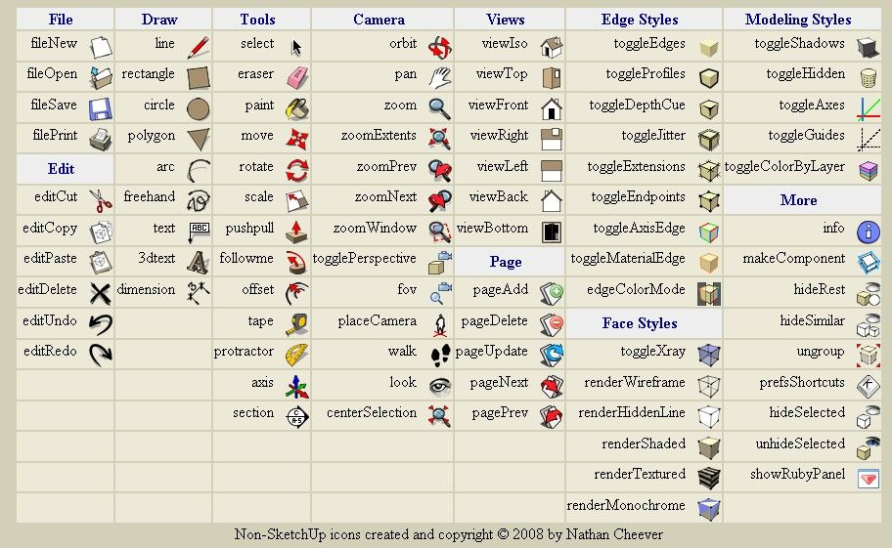

Slide 8
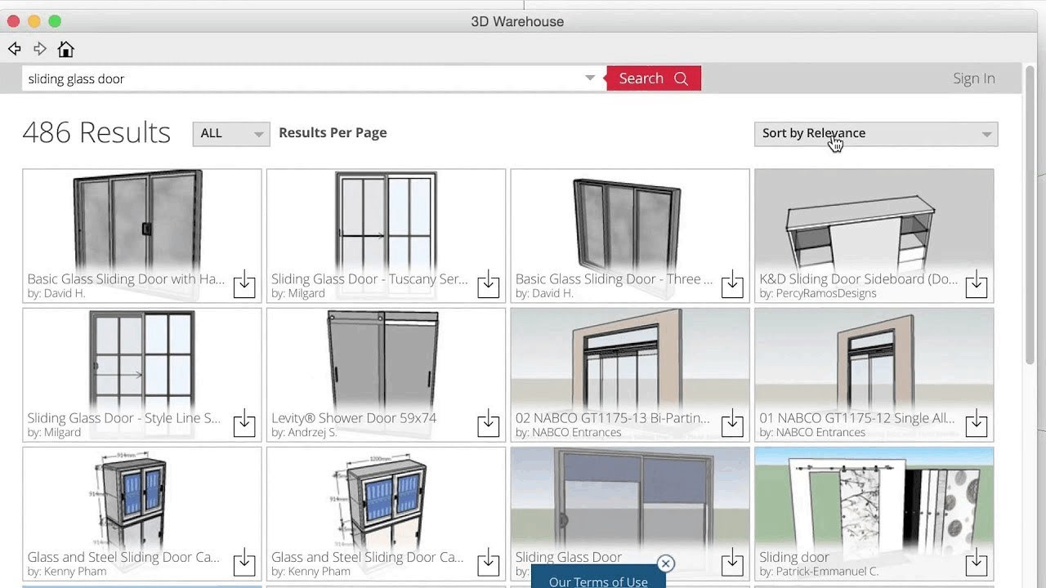
3D WAREHOUSE
3D Warehouse is an open library in which SketchUp users may upload and download 3D models to share. The models can be downloaded right into the program without anything having to be saved onto your computer's storage. File sizes of the models can be up to 50 MB. Anyone can make, modify and re-upload content to and from the 3D warehouse free of charge.
All the models in 3D Warehouse are free, so anyone can download files for use in SketchUp or even other software such as AutoCAD, Revit and ArchiCAD - all of which have apps allowing the retrieval of models from 3D Warehouse. SketchUp designers may visit 3D Warehouse to discover new products or for inspiration when designing their own.

Slide 9
STEPS FOR CREATING A STRUCTUTRE
Select the person, context-click the selection, and select Erase in the context menu that appears.
In the Getting Started toolbar, select the Rectangle tool .
On the ground plane, in the space between the red and green axis, click the Rectangle tool cursor .
On the Getting Started toolbar, select the Push/Pull tool, and place the Push/Pull cursor over the rectangle you just created.
Click and drag your rectangle up into a 3D shape. Keep an eye on the Measurements box and release the cursor when your shape is about 5 feet tall.
In the Getting Started toolbar, click the Paint Bucket tool
In the Materials panel that appears, select Colors from the drop-down menu, as shown here. Then select a color from the options that appear on the Select tab
Close the Materials panel and select Window > Styles

